Slide 1



UNIMA CONGRESS & WORLD PUPPETRY FESTIVAL
13-19 APRIL 2020, GIANYAR-BALI

Slide 2


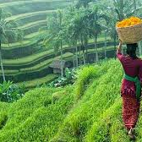
INTRODUCTION
The official Website of Indonesia Tourism. Bali is a popular tourist destination, which has seen a significant rise in tourists since the 1980s.Tourism-related business marks 80% of its economy. It is renowned for its highly developed arts, including puppetry, traditional and modern dance, sculpture, painting, leather, metalworking and music. In March 2017, TripAdvisor named Bali as the world's top destination in its Traveler's Choice award (source: Wikipedia)
For further information, please visit the official website of Tourism Wonderful Indonesia: www.Indonesia.travel

Slide 3
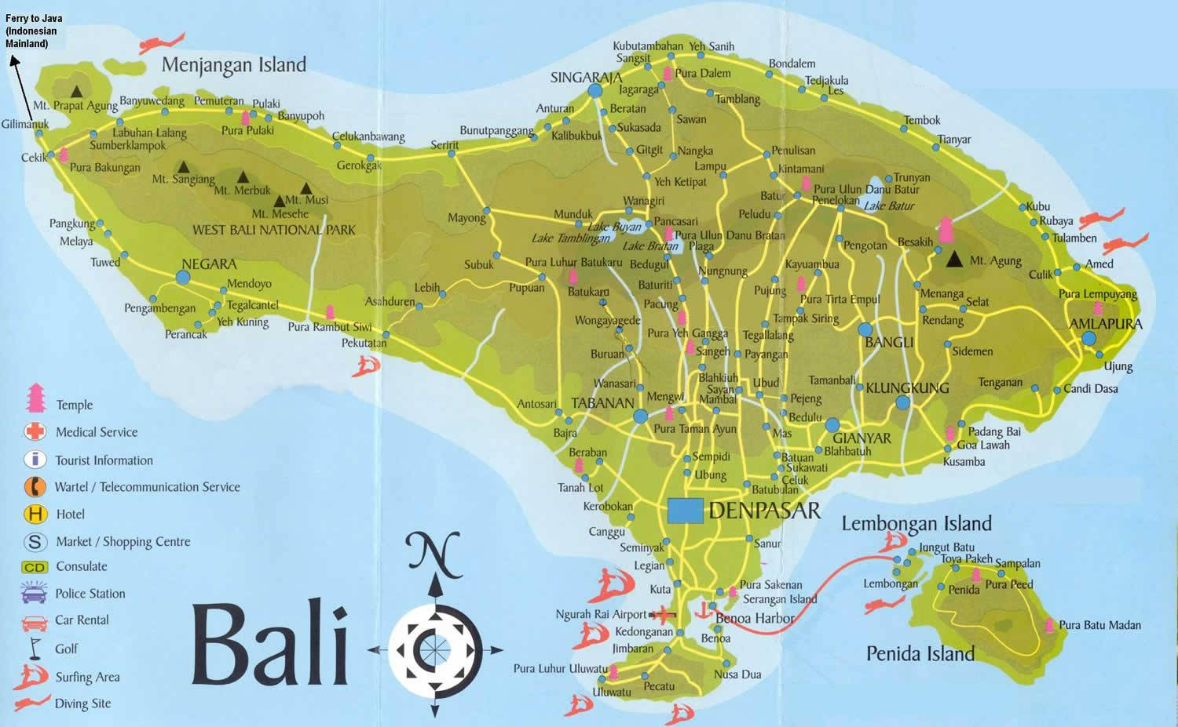
MAP OF BALI

Slide 4
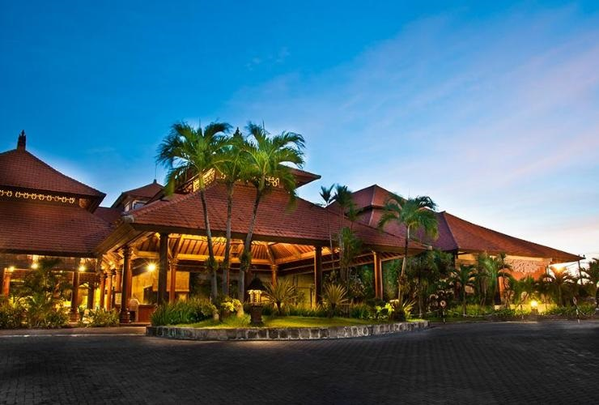
CONGRESS
UNIMA Congress in Bali 2020 will be held at PRIME PLAZA HOTEL in Sanur Bali, 4-Star Hotel with 329 rooms (30 minute-drive from Ngurah Rai airport, Denpasar Bali)
I.PROGRAM- CONGRESS –SEMINAR FESTIVAL
13 April - Executive Committee Meeting
13 April - Opening Ceremony at Astina Square
14 to 18 April - Congress
16 April - Gala Dinner (free of charge for the registered participants)
17 April - Anniversary of Gianyar (Parade)
17 April - Excursion
18 April – 8:00-11:00 Congress
15:00-21:00 Seminar
19 April: Seminar @ Indonesian Art Institute, Denpasar
New Executive Committee meeting
19th April - Closing Ceremony at Astina Square

Slide 5
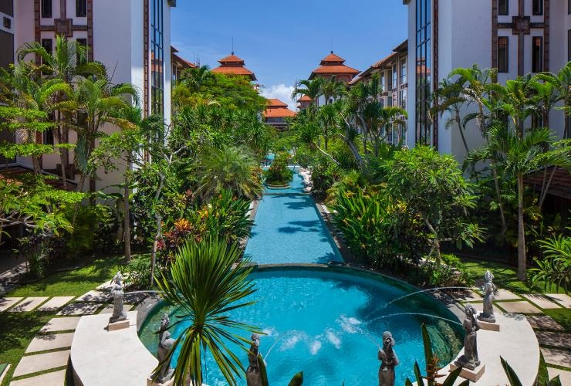
SEMINAR
SEMINAR at Indonesian Art Institute Denpasar{ISI}
The seminar theme:
Puppetry Uniting/Unifying People.
Puppetry as an Imagined Community or
Puppetry as Community of Hope .
Possible sub themes include:
Affiliation, friendship, and love among puppeteers.
Conflict negotiation and resolution through puppetry.
Formulating and implementing multiculturalism and humanistic values through puppetry.
Puppetry in pursuit of world peace and universal communities.

Slide 6
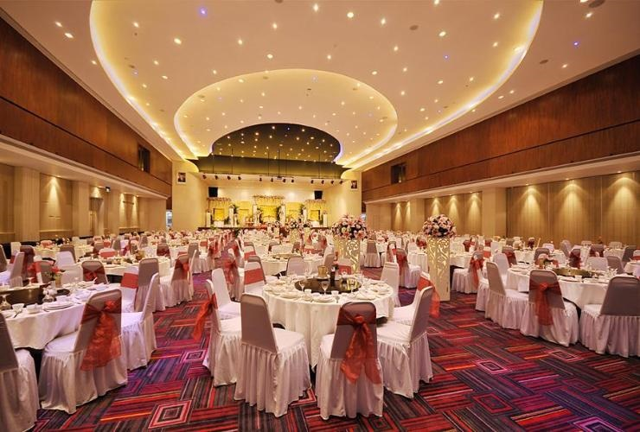
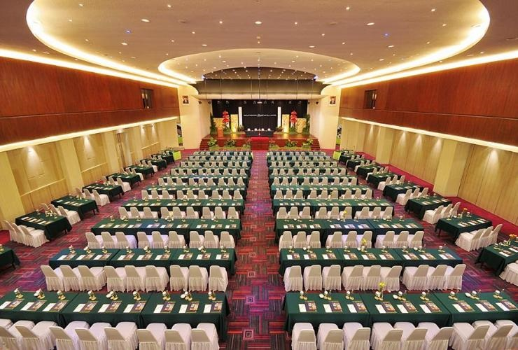
CONGRESS
For the Congress, UNIMA Indonesia provides:
1 Room for secretariat 2nd Floor, Bedugul Room with table, chairs, printer, photocopier, WIFI
For congress 2nd Floor, Griya Agung Ballroom
Executive Committee meeting , 2nd Floor Legian room
For performance 3rd Floor, Denpasar room, Outdoor
CONGRESS fee includes: 2 coffee breaks, lunch, dinner, ticket pass for festival transfers to different venues, local transportation, excursion, opening-closing ceremony, dossier
SEMINAR Fee includes: coffee break, lunch, local transportation, festival pass, excursion, opening - closing ceremony
FESTIVAL Fee includes: lunch, local transportation, festival pass, excursion, opening - closing ceremony
II. OPENING AND CLOSING CEREMONY
Opening Ceremony on April 14th & Closing Ceremony on April 19th at Astina Square

Slide 7
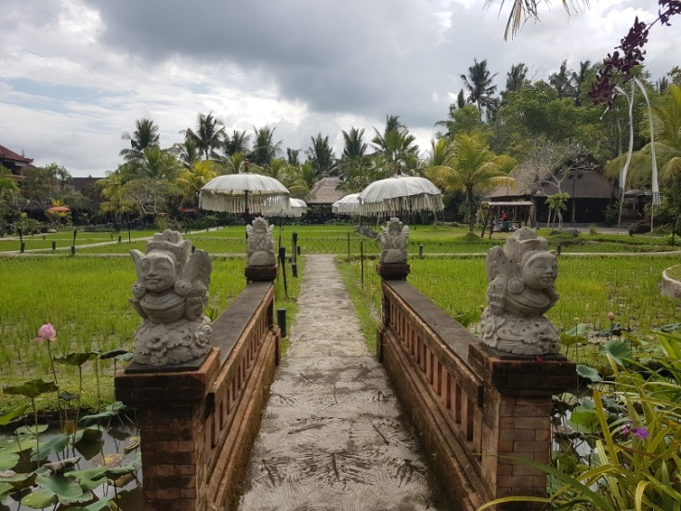
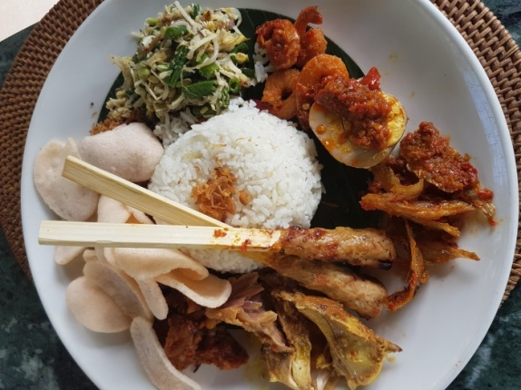
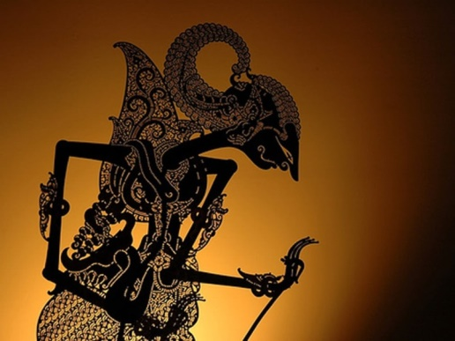
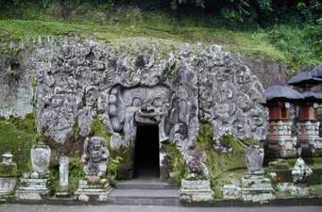
EXCURSION
The Excursion includes below activities:
Ubud Market for souvenir, batik, handicraft
Lunch at Bebek Tepi Sawah Restaurant (rice field view)
Gua Gajah (Elephant Cave)
Rumah Topeng Wayang (Marionette Museum)

Slide 8
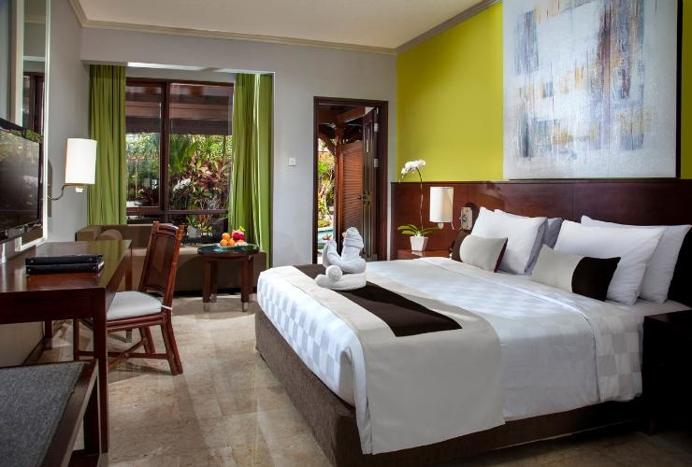
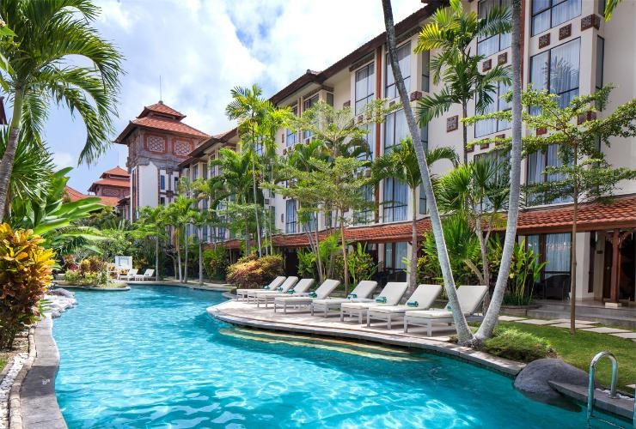
HOTEL
Information regarding the Hotel for participants of Congress and Festival:
Prime Plaza Hotel Sanur, Bali (40-minute drive from Ngurah Rai Airport, Bali)
Hotel Rates: IDR 800,000 (+/- 50.00 Euro) per night (Includes room and breakfast) Contact:
www.jojo@sanur.pphotels.com
www.apphp.hotels.com
Ph.+62 361281781
Puri Dalam Hotel (small hotel close to Congress)
Hotel Rates: IDR 500,000 (+/- Euro 35.00) per night (Includes 2 single bed and breakfast) Contact:
Email.info@puridalamhotelbali.com
Ph. +62 813 38726455
Hotel Sanur Agung
Hotel Rates: IDR 350,000 (+/- Euro 22.00) per night (Includes 2 single bed and breakfast)
Contact: Nanik Yuli Hastuti
Email: sales@hotelsanuragung.com
Ph.+62.0361 288409
ALL PARTICIPANTS MUST CONTACT & RESERVE DIRECTLY TO THE HOTEL

Slide 9
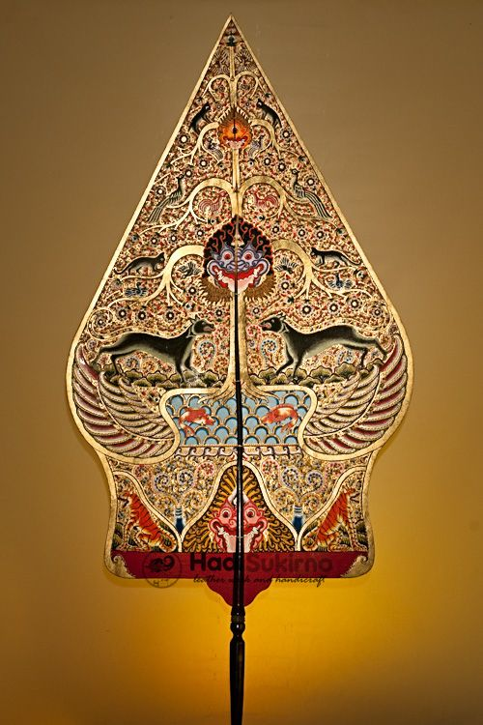
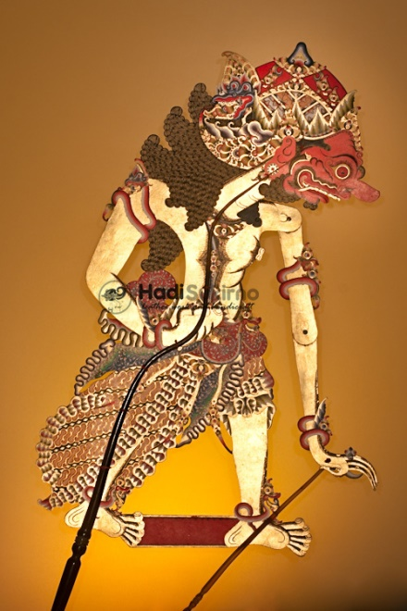
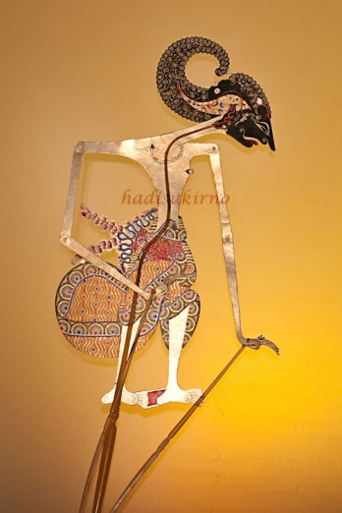
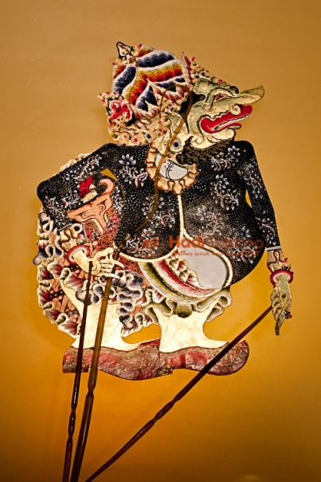
FESTIVAL
For the Festival, UNIMA Indonesia will invite local troops and foreign troops coming from: China, Iran, Japan, India, Philippines. We will provide the following:
Local transportation
Venue for Festival
Hotel (indoor or outdoor)
Astina Square
Mask Museum (Rumah Topeng)

Slide 10
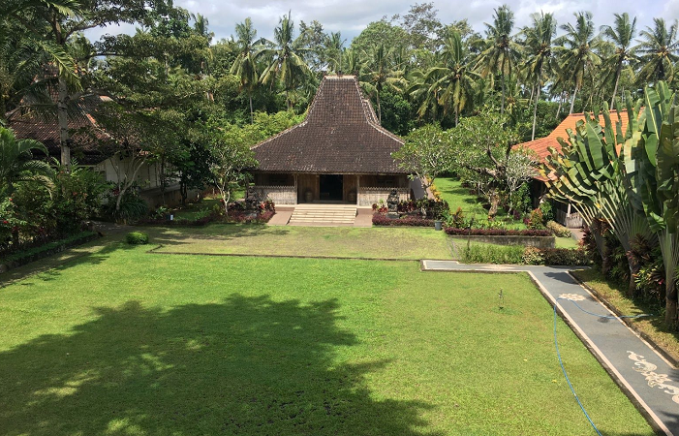
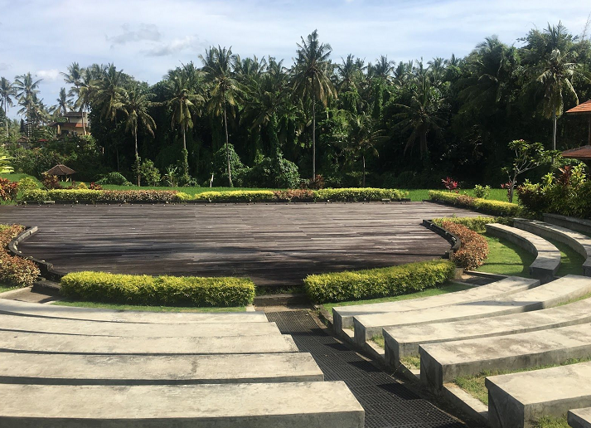
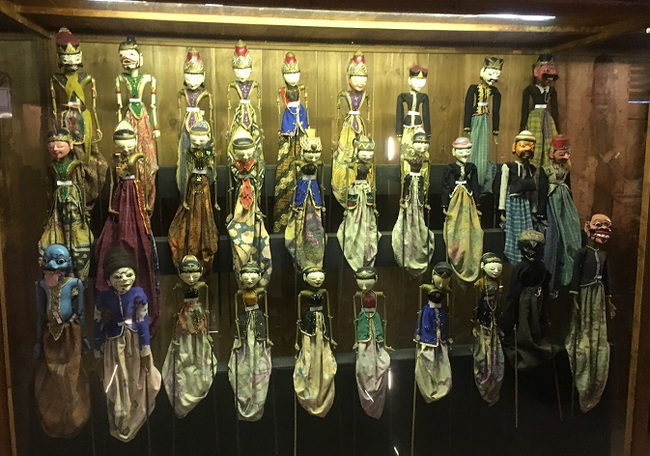
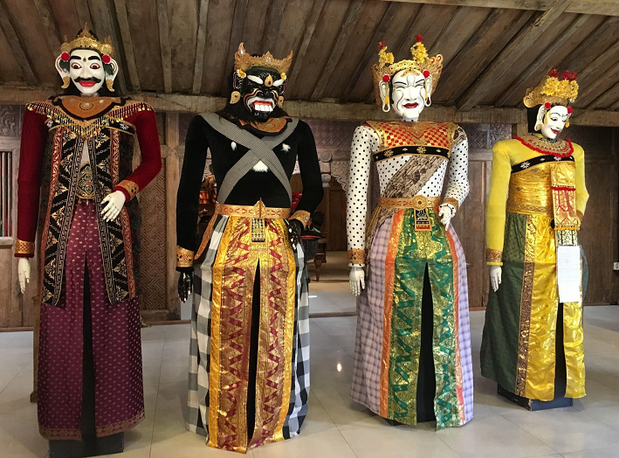
FESTIVAL
RUMAH TOPENG (MARIONETTE MUSEUM)

Slide 11
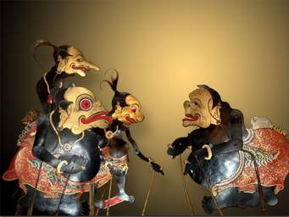
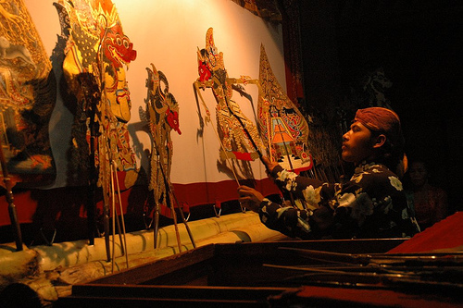
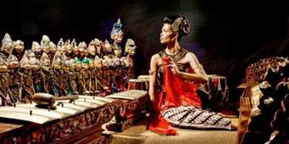
FESTIVAL
INTERPRETER
We will provide a professional interpreter in English, French and Spanish
SPONSORS
Government
Bank
Private Companies

Slide 12
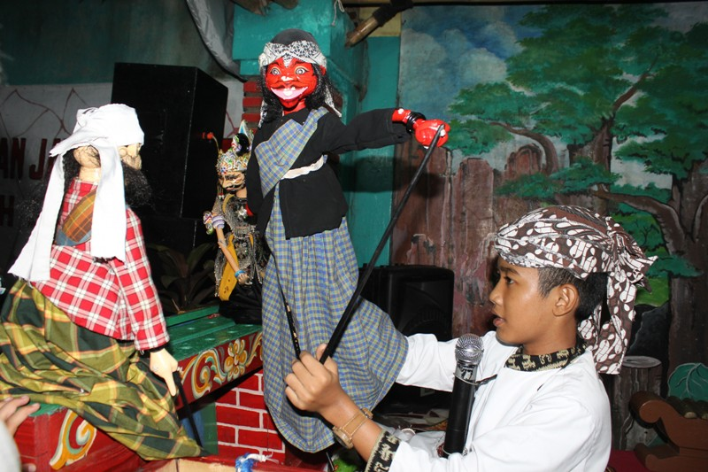
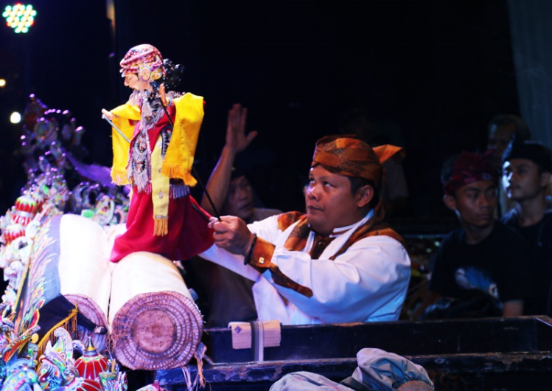
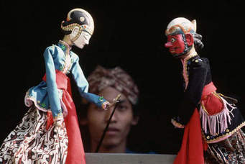
FESTIVAL
INTRODUCTION
In general, the audience of Puppetry Festival consists of UNIMA members along with their friends who are highly interested in the event.
It is a great opportunity for all the countries to present the UNIMA representatives deriving from all over the world to experience the richness of our Puppetry traditions.
The country and region in which UNIMA Congress and Puppetry festival are held, have the opportunity to showcase puppetry from that country and from a geographical region.

Slide 13
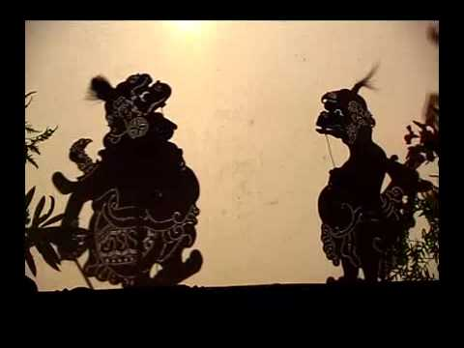
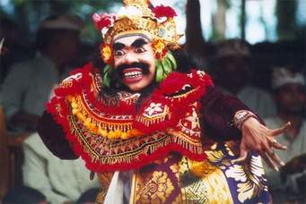
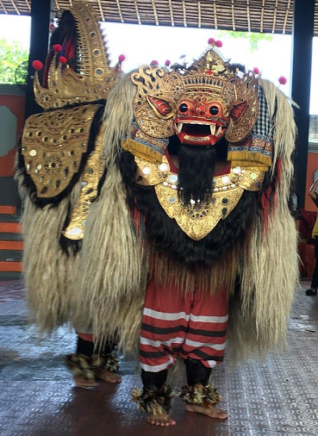
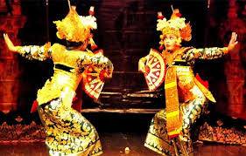
PROGRAM OF ACTIVITIES
BALI
Foreign visitors (UNIMA members and their friends) including local Balinese will be highly interested in seeing the local Balinese wayang. There are a variety of Balinese wayangs which are rich in culture and greatly entertaining.
Opening Ceremony of the Festival will be centralized at Astina Square. The child Puppeteer from Bali will be the starting point of the performance, which will feature Cenk blonk or Balinese puppet and narrator by I Made Sidia from Sanggar Paripurna, Gianyar.
In addition, the performance will continue with Barong Dance, Tambulilingan dance, Baris dance, Manuk Rawa dance, Kecak dance.
Decorations of the temple will be conducted by I Made Sidia group.

Slide 14
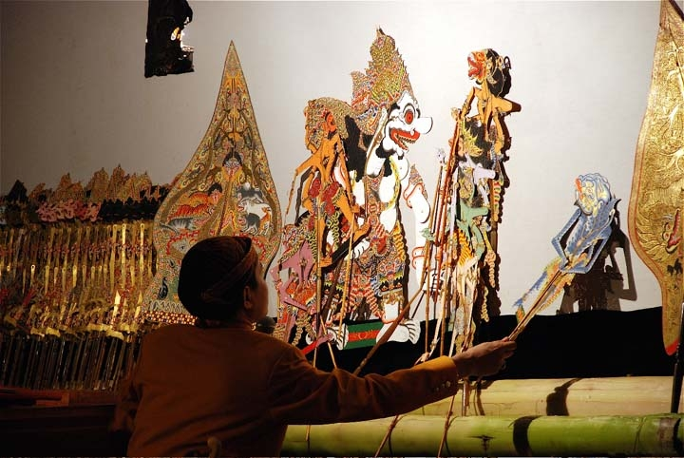
PROGRAM OF ACTIVITIES
CENTRAL JAVA
Shadow puppet performances will also be conducted by a young/child puppeteer which will take the role of Kresna Duta, Lahire Wisanggeni, Sesaji Raja Suya
WEST JAVA
Wayang Golek is the most popular in West Java which will be performed by a young/child puppeteer who will take the role of Gugurnya Dasamuka, Shinta Kidnapping

Slide 15
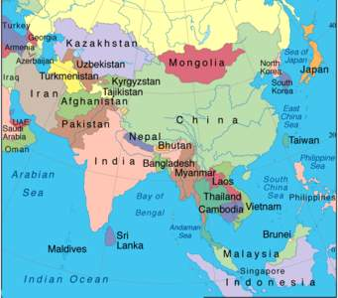
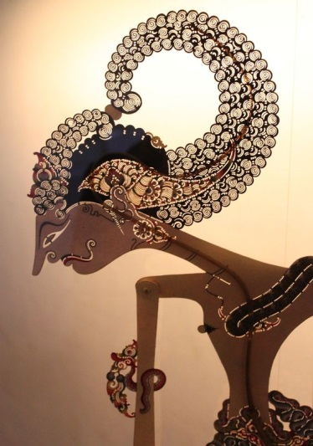
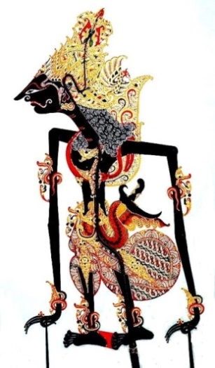
PROGRAM OF ACTIVITIES
During the World Festival, apart from Indonesian puppet performances, we will also highlight some of the puppetry traditions and modern and performances from other countries from 5 continent

Slide 16
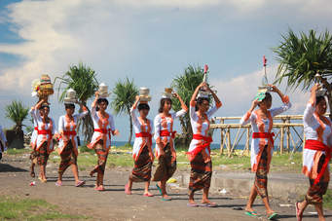
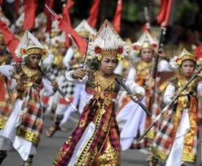
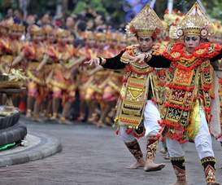
PROGRAM OF ACTIVITIES
VENUE FOR FESTIVAL
Some performances will be located at Prime Plaza hotel
The other performances will take place at other regions of Gianyar as suggested by the incumbent Regent of Gianyar
STREET PERFORMANCES
Performances will be conducted on the streets near Prime Plaza hotel.

Slide 17
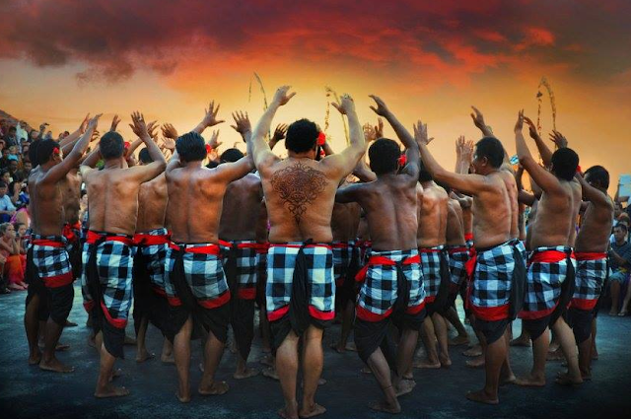
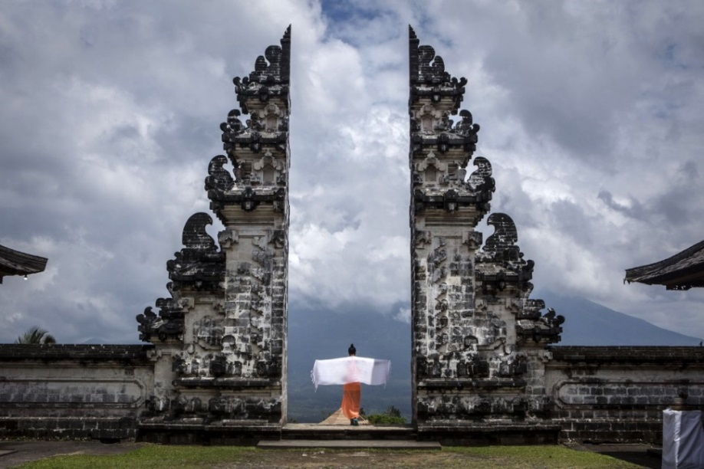
PROGRAM OF ACTIVITIES
JOIN THE PARADE
To mark the Anniversary of the Gianyar Regency on April 17th, we will highlight a spectacular parade consists of thousands of Balinese culture , Dancers and Marionnettes.
It is highly recommended for the members of UNIMA World Puppetry Festival to participate at this Parade as well.

